Slide 1
CAPSTONE PROJECT
DATA SCIENCE PROJECT
PRESENTED BY :
RAHUL K – 2021303030 – CHEMICAL ENGINEERING

Slide 2
OUTLINE
Problem Statement
Proposed System/Solution
System Development Approach
Algorithm & Deployment
Result
Conclusion
Future Scope
References

Slide 3
PROBLEM STATEMENT
Python Program for Railway Reservation System

Slide 4
PROPOSED SOLUTION
To develop a Python program for railway ticket booking, you'll need to design and implement a system that handles various aspects such as train schedules, seat availability, user authentication, booking transactions, and more. Below are proposed solutions covering key functionalities and considerations for building a railway ticket booking program in Python:
1.⁠ ⁠Object-Oriented Design (OOD): Use classes and objects to model entities like Train, Ticket, User, and Booking. This facilitates a structured approach to representing railway system components.
2.⁠ ⁠User Authentication and Management: Implement user authentication functionalities to allow users to create accounts, log in, and manage their profiles.

Slide 5
3.⁠ ⁠Train and Seat Management Solution: Manage train schedules, seat availability, and bookings within the booking system.
4.⁠ ⁠Booking Transactions: Implement logic to handle booking transactions, including seat reservations and ticket issuance.
5.⁠ ⁠Data Persistence and Storage: Implement data storage using file handling or databases (e.g., SQLite, PostgreSQL) to persist train schedules, user information, and booking records.

Slide 6
SYSTEM APPROACH
1. User Interface:
Frontend Interface: Users interact with the system through a graphical user interface (GUI) or command-line interface (CLI).
Input Validation: Validate user inputs to ensure correctness and prevent invalid data entry.
2. Data Management:
Trains Data:
Maintain a database or data structure to store information about trains, including train number, name, available seats, departure time, and possibly other attributes like class, fare, etc.
Store this data in a format that allows for efficient retrieval and modification.
Bookings Data:
Store information about bookings, including booking ID, train number, number of seats booked, and passenger details (name, age, contact).
Each booking should be linked to a specific train and have a unique identifier.

Slide 7
Functionalities:
Display Available Trains:
Retrieve information about available trains and display them to the user.
Include details like train number, name, available seats, departure time, etc.
Book Tickets:
Allow users to book tickets for a selected train.
Collect necessary details like train number, number of seats, passenger information.
Update the available seats for the selected train after booking.
Cancel Tickets:
Enable users to cancel their booked tickets by providing the booking ID.
Update the available seats for the respective train after cancellation.
View Booking Details:
Allow users to view details of their booked tickets by providing the booking ID.
Display booking details including train number, number of seats booked, passenger details, etc.

Slide 8
4. Business Logic:​
Validation:​
Validate user inputs to ensure they are within acceptable ranges and formats.​
Check for seat availability before booking.​
Handle edge cases and error conditions gracefully.​
Concurrency Control:​
Implement measures to handle concurrent access to the same data, preventing race conditions and ensuring data integrity.​
Use locks or other synchronization mechanisms if necessary.
5. Security:
User Authentication:
Implement user authentication to ensure only authorized users can access certain functionalities (e.g., booking, cancellation).
Protect sensitive data like user passwords using encryption.
Data Privacy:
Ensure that passenger details are stored securely and access is restricted to authorized personnel only.

Slide 9
6. Administration:​
Admin Interface:​
Provide an interface for administrators to manage trains, bookings, and user accounts.​
Allow admins to add/remove trains, modify seat availability, view booking history, etc.
7. Error Handling and Logging:
Error Handling:
Handle errors gracefully and provide informative error messages to users.
Log errors and exceptions for debugging and monitoring purposes.

Slide 10
ALGORITHM & DEPLOYMENT
Algorithm:
1. Initialization:
Initialize the RailwayReservationSystem class.
Initialize train data and booking data (either from a file/database or hardcoded).
2. Display Menu:
Display a menu with options: Display Trains, Book Ticket, Cancel Ticket, View Booking Details, and Exit.
3. Display Trains:
Iterate through the train data and display train details (train number, name, departure time, and available seats).

Slide 11
4. Book Ticket:​
Prompt the user to enter the train number, number of seats, and passenger details.​
Check if the train exists and if there are enough available seats.​
If valid, decrement the available seats, generate a booking ID, and store booking details.​
Display a success message with the booking ID.
5. Cancel Ticket:
Prompt the user to enter the booking ID to cancel.
Check if the booking ID exists.
If valid, increment the available seats, remove the booking from the booking data.
Display a success message.

Slide 12
6. View Booking Details:
Prompt the user to enter the booking ID.
Display the details of the booking if the ID exists.
7. Exit:
Exit the program.

Slide 13
Deployment:
1. Local Deployment:
Run Locally: Run the Python program on a local machine.
Installation: Ensure Python is installed. Execute the program in a Python IDE or command line.
Advantages: Simple setup, suitable for development and testing.
Disadvantages: Not accessible remotely, requires installation on each machine.
2. Web Application:
Web Framework: Use Python web frameworks like Flask or Django.
Deployment Platform: Deploy the web application on platforms like Heroku, AWS, or DigitalOcean.
Advantages: Accessible from any device with an internet connection, scalable, and easier maintenance.
Disadvantages: More complex setup, requires web development skills.

Slide 14
3. Cloud Deployment:
Serverless Computing: Utilize serverless platforms like AWS Lambda or Google Cloud Functions.
Containerization: Use Docker containers and deploy on container orchestration platforms like Kubernetes.
Advantages: Scalable, cost-effective, and managed infrastructure.
Disadvantages: Learning curve for setting up serverless or containerized environments.
4. Desktop Application:
GUI Framework: Use Python GUI frameworks like Tkinter, PyQt, or wxPython.
Deployment: Package the application using tools like PyInstaller or cx_Freeze.
Advantages: No need for internet connection, easy distribution.
Disadvantages: Platform-dependent, less accessible than web applications.

Slide 15
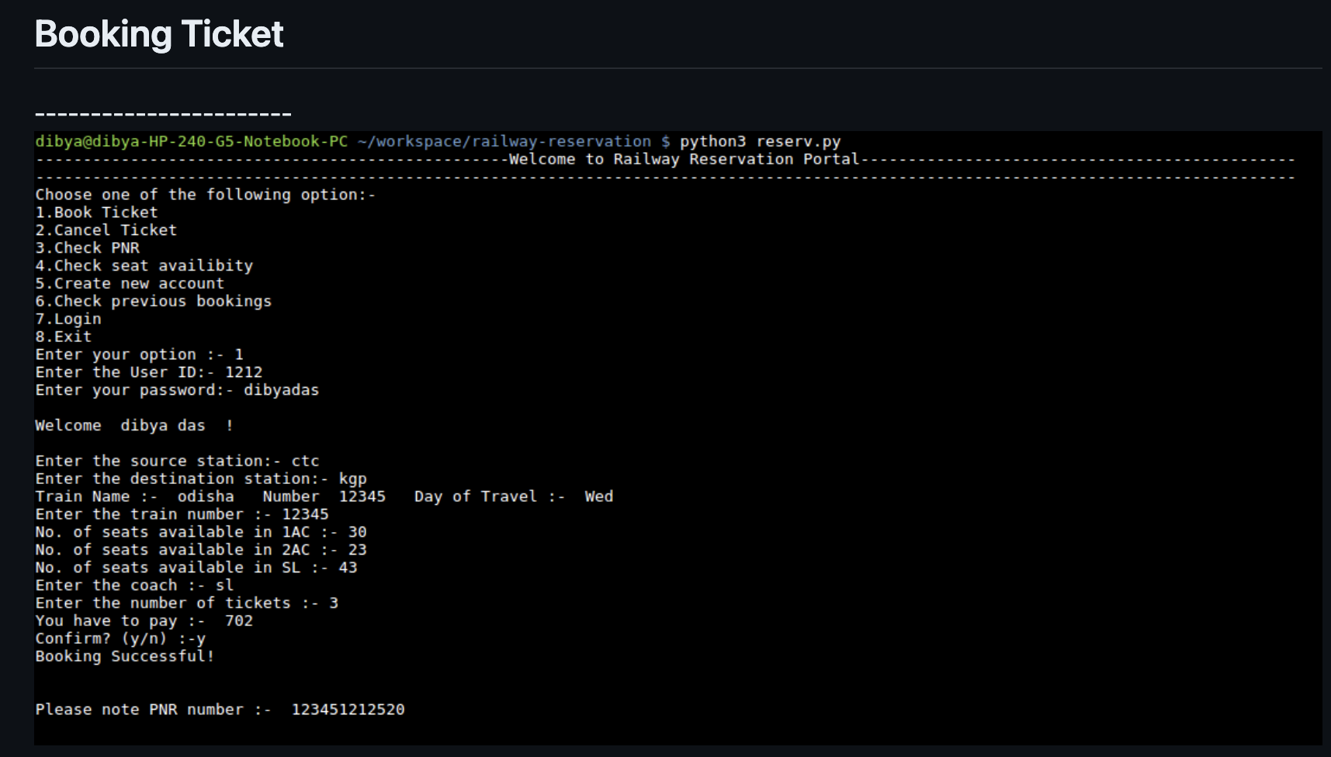
RESULT

Slide 16
CONCLUSION
The Railway Reservation System is a crucial system that facilitates the booking and management of train tickets. In this system, we have designed a Python program to handle basic functionalities like booking tickets, canceling tickets, and viewing train details.
Key Points:
Functionality: Users can view available trains, book tickets for a specific train, cancel booked tickets, and view booking details.
Data Management: Train data and booking data are stored using dictionaries and lists.
User Interface: The system provides a simple menu-driven interface for users to interact with.

Slide 17
4. Error Handling: Input validation and error messages are provided to ensure smooth user experience.
5. System Design: The system is designed with clear components: user interface, data management, functionality, error handling, and control flow.
6. Optional Features: The system can be extended with features like user authentication, admin interface, and data persistence.

Slide 18
FUTURE SCOPE
Mobile Ticketing and NFC Technology
AI-Powered Customer Service
Dynamic Pricing and Revenue Management
4. Predictive Maintenance
5. Biometric Identification and Security
6. Integration with Public Transport
7. Augmented Reality (AR) for Navigation

